Slide 1
Superstore Sales Analysis
Data Visualization & Storytelling

Slide 2
Introduction (Slide Content):
Welcome to the visual report created as part of the Data Analyst Internship – Task 2.
This report presents an insightful analysis of a U.S.-based retail company's sales data using Tableau. The dataset includes over 2,000 orders spanning multiple categories, segments, states, and shipping modes between 2013 and 2017.
Through a series of data visualizations, we uncover key business trends, customer behavior patterns, and operational insights to support data-driven decisions.

Slide 3
Key Objectives:
Understand sales and profit trends over time
Identify top- and bottom-performing products and segments
Analyze regional sales patterns and shipping efficiency
Evaluate the impact of discounting on profitability

Slide 4
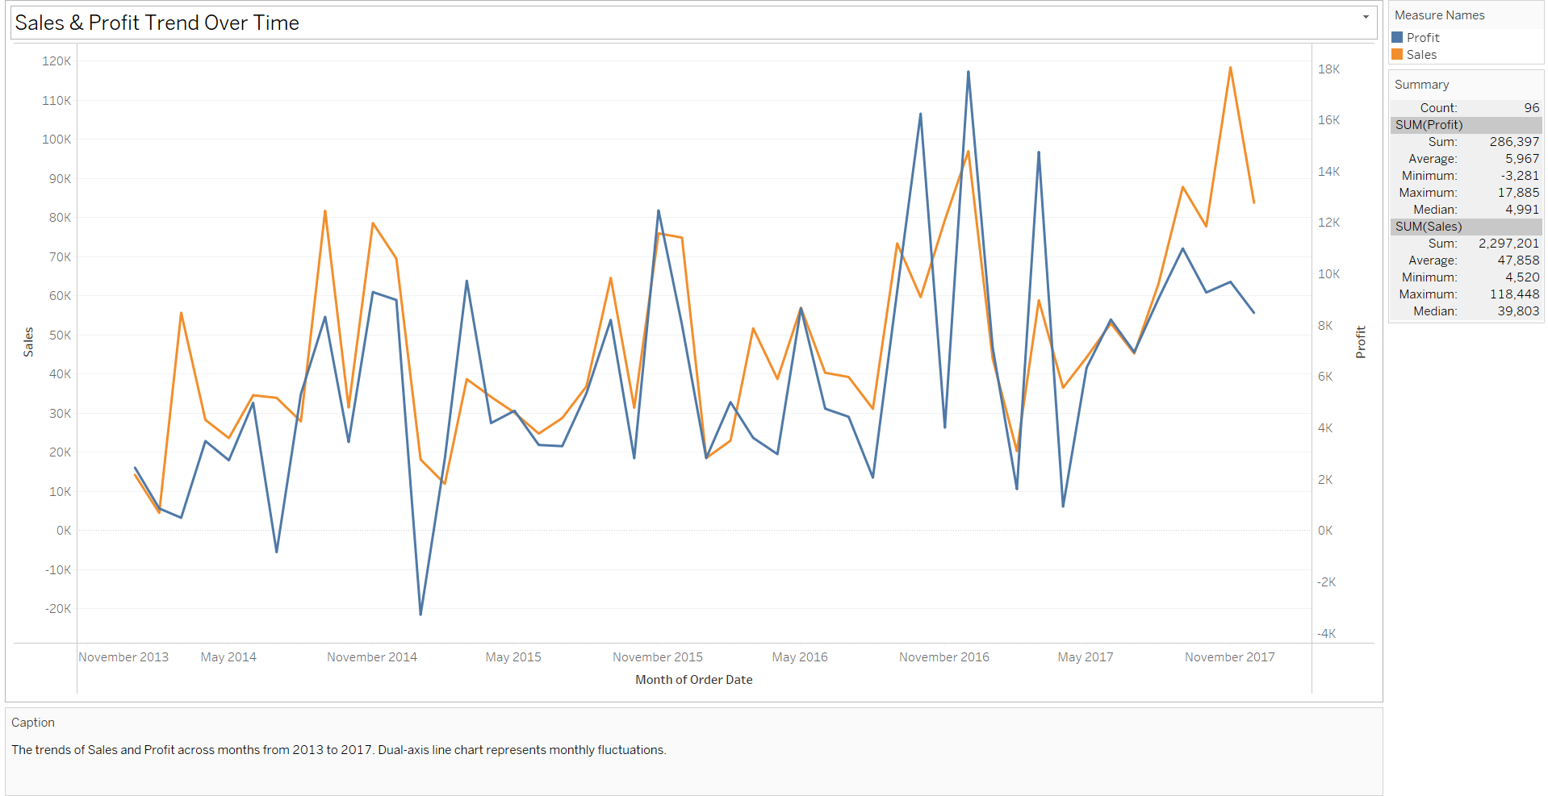
Monthly Sales and Profit Trends (2013–2017)
Sales and profit generally increased over time, but profit showed higher volatility with several negative dips—indicating possible issues like discount overuse or high-cost periods.

Slide 5
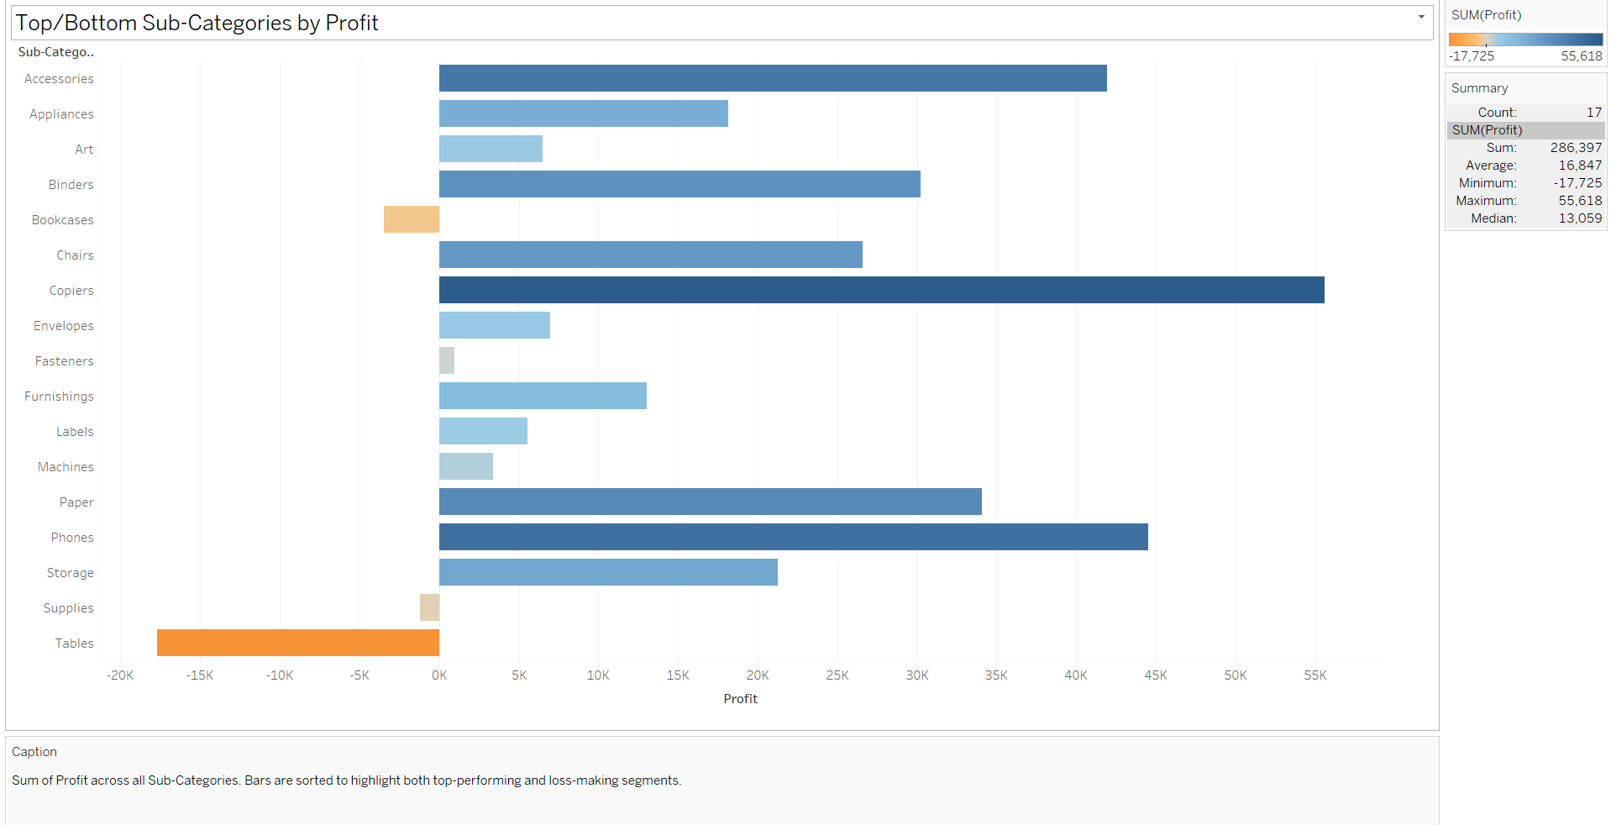
Profitability Analysis by Product Sub-Category
Copiers and Phones generated the highest profits, while Tables and Bookcases resulted in significant losses and may need strategy revision.

Slide 6
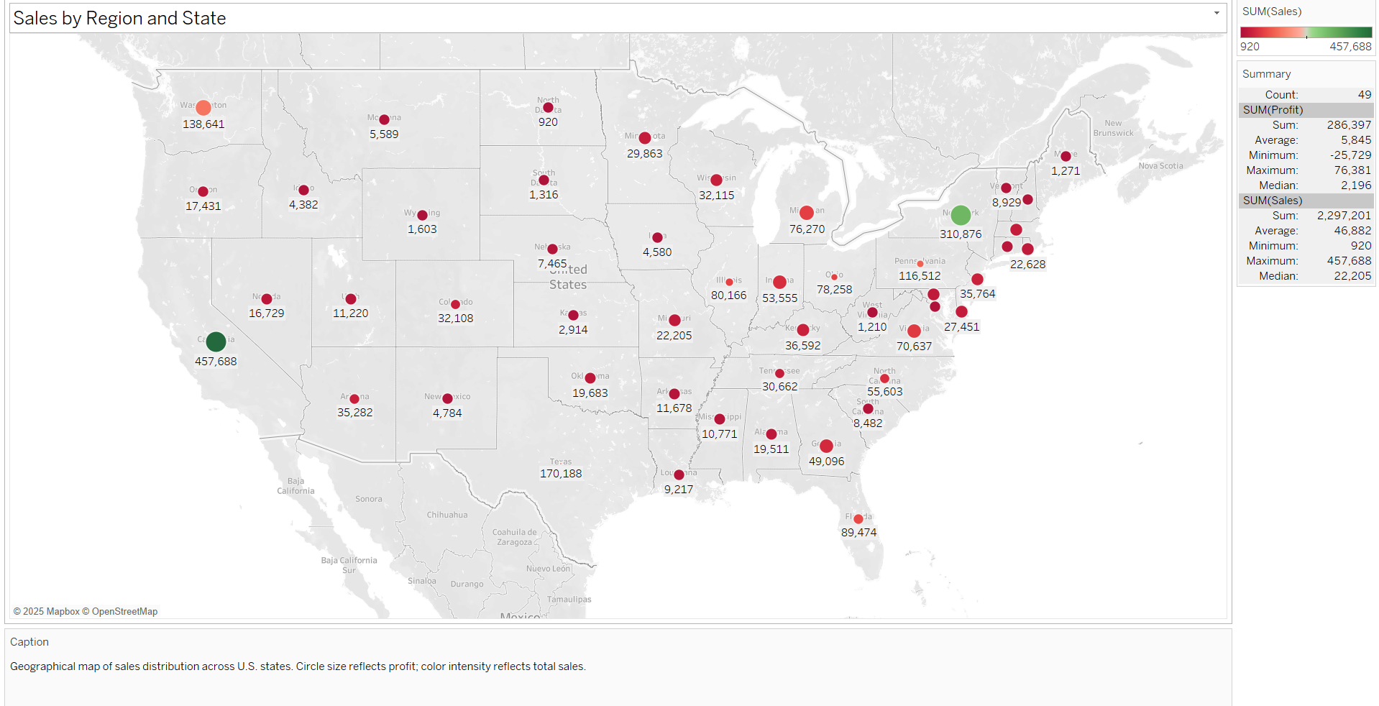
Geographical Sales and Profit Distribution Across States
California, New York, and Texas dominate in sales and profit, while states like Wyoming and South Dakota contribute minimally and may need marketing focus.

Slide 7
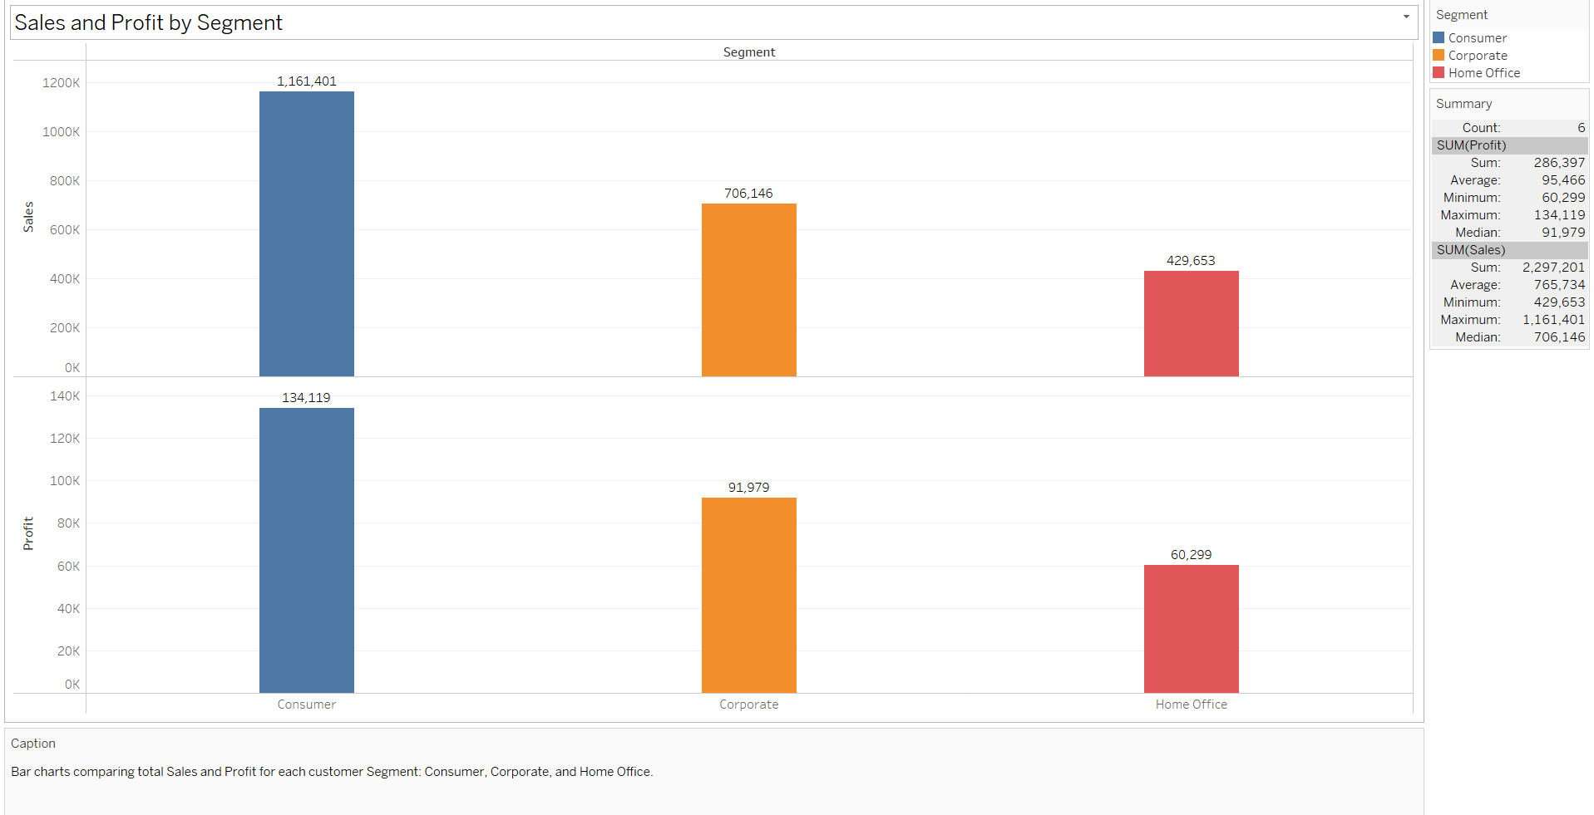
Customer Segment-Wise Sales and Profit Performance
The Consumer segment leads in both sales and profit, making it the most valuable segment for continued targeting.

Slide 8
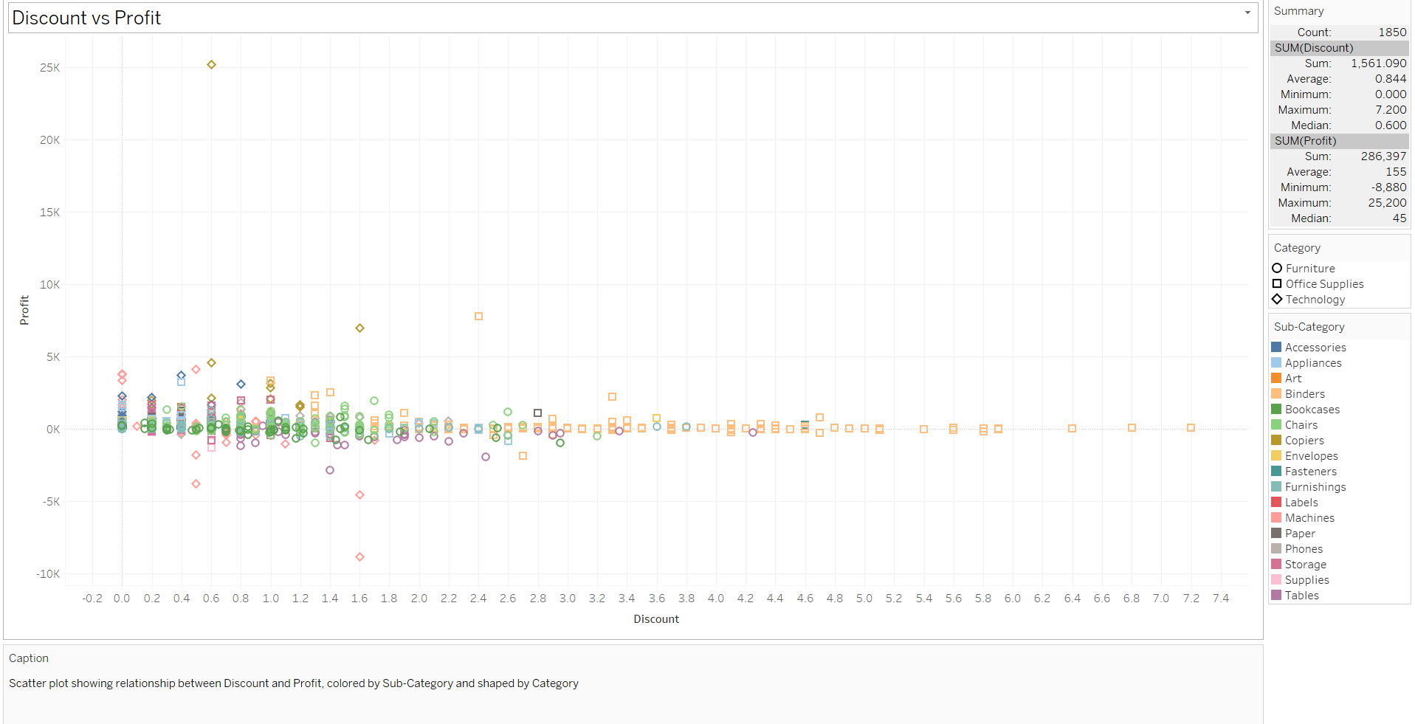
Impact of Discounts on Profitability Across Categories
Higher discounts often correlate with reduced or even negative profits, especially in Office Supplies—indicating that discount strategies may need refinement.

Slide 9
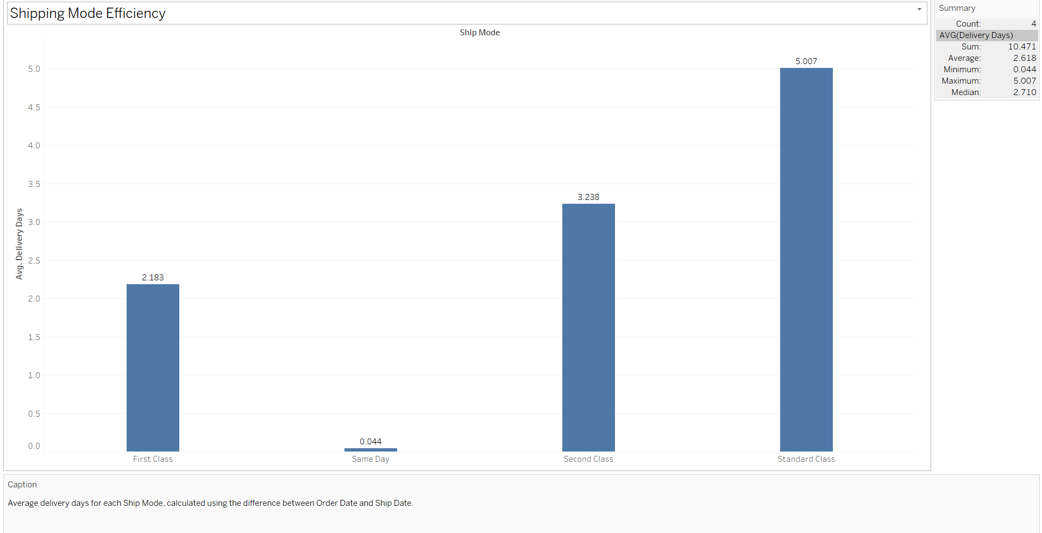
Average Delivery Days by Shipping Mode
Same Day shipping is the fastest as expected, while Standard Class averages the longest delivery time, potentially affecting customer satisfaction in some segments.

Slide 10
Summary of Findings
Sales and profit have grown consistently, but profit volatility suggests operational inefficiencies.
Copiers and Phones are the most profitable sub-categories; Tables and Bookcases underperform.
California, New York, and Texas drive most revenue; low-performing states need strategic attention.
The Consumer segment is the most profitable, highlighting key demographic focus.
High discounts often lead to lower profits, especially in Office Supplies.
Same Day shipping performs best in delivery time, while Standard Class is the slowest.

Slide 11
THANK YOU

